Slide 1








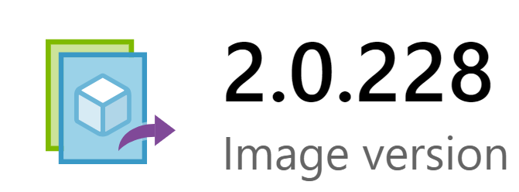
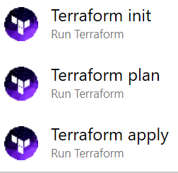
Packer Image Build Pipeline workflow in Azure Devops
1
Sources in Azure Repo
Packer json file stored in Repo
Shared Image Gallery Terraform folder
Tokenize variables that will be passed in during build
Service Principal
Hosted (or private) agent
Marketplace Image
2
Create a Build Pipeline with hosted agent pool. Communication initiated by Hosted Agents
Packer task
Temporary
Managed Image
3
Define Pipeline variables and assign values.
Create a Service Principal if needed
Target Resource group for managed image
Shared Image Gallery name and version
Build assumes gallery is already created
DevOps Azure Repos
Build Pipeline
4
Configure Build Tasks
Replace Tokens task will take pipeline variables as input and replace the tokens in the files stored in the repo.
Packer image task will create an updated managed image in a resource group based on marketplace OS image of choice.
Terraform tasks will publish managed image to a shared image gallery and share it with users in a subscription.
Tasks
Terraform task
Shared
Image Gallery

Slide 2


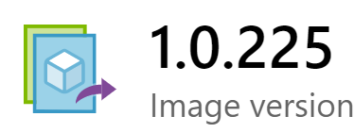
Packer Image Build Pipeline (custom app image) in Azure Devops
1
Sources in Azure Repo
Packer json file stored in Repo
Shared Image Gallery Terraform folder
Tokenize variables that will be passed in during build
Shared
Image Gallery
Service Principal
Hosted (or private) agent
2
Create a Build Pipeline with hosted agent pool. Communication initiated by Hosted Agents
Application-specific artifacts can be sourced from a build artifact or another artifact repo.
Packer task
DevOps Azure Repos
Build Pipeline
Generic AT&T OS Image
3
Define Pipeline variables and assign values.
Create a Service Principal if needed
Target Resource group for managed image
Shared Image Gallery name and version
Build assumes gallery is already created
Application-specific
Binary/customizations
Tasks
Temporary
Managed Image
Terraform task
4
Configure Build Tasks
Replace Tokens task will take pipeline variables as input and replace the tokens in the files stored in the repo.
Packer image task will create an updated managed image in a resource group based on customized/sanctioned AT&T gallery image published earlier.
Terraform tasks will publish managed image to a shared image gallery and share it with users in a subscription.
Shared
Image Gallery
Customized AT&T OS Image

Slide 3

Azure Shared Image Gallery Pipeline for VM Scale Set Deployments
1
Sources in Azure Repo
Packer json file stored in Repo
VMSS main Terraform folder and modules folder
Prefix and suffix tokens configured for variables.tf
Shared
Image Gallery
Service Principal
Hosted (or private) agent
2
Create a Build Pipeline with hosted agent pool. Communication initiated by Hosted Agents
Customized AT&T OS Image
3
Define Pipeline variables and assign values.
Create a Service Principal if needed
Target Resource group for managed image
Shared Image Gallery name and version
Build assumes gallery is already created
DevOps Azure Repos
Build Pipeline
Application Resources
4
Configure Build Tasks
Replace Tokens task will take pipeline variables as input and replace the tokens in the files stored in the repo.
Terraform tasks will create VMSS resources based on input variables. Inject additional files or app deployment using CloudInit or Custom Script Extensions
Tasks

